Slide 1
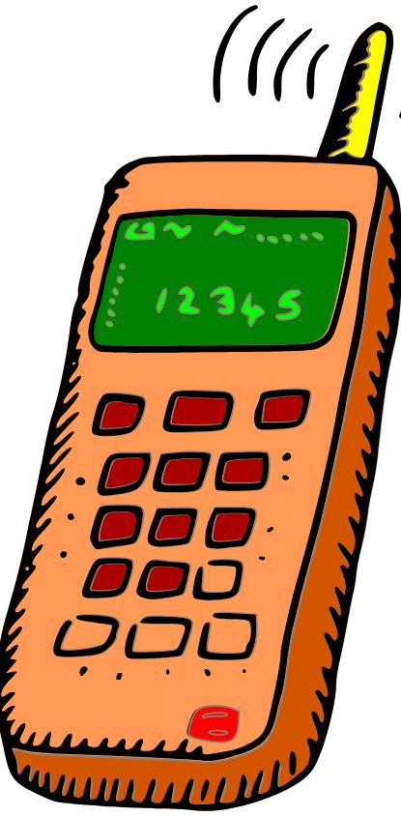
Welcome to Mr. Washington’s
8th Grade Ga Studies Class!
8th Grade Ga Studies Expectations/ Syllabus
You are expected to write notes, use graphic organizers, practice concepts, read, complete projects, and study. You are also required to complete a Major Social Studies Research & Project (by yourself or as a small group).
You must prepare yourself by keeping an interactive notebook. This notebook must be with you in class everyday. There are NO EXCEPTIONS!! Your interactive notebook will help you on your exploration, discovery & studies of Georgia.
If you are absent, it is your responsibility to get the notes and any other information OR ASSIGNMENTS you missed during your absence.
Each week you will be given an assessment over the TAUGHT material.
Remember, it is your responsibility to keep up with your stuff!
Arrive to class on time!
Be ready to learn.
Standards Based Instruction: This course will include information in compliance with the Georgia Performance Standards (GPS)/ Common Core Georgia Performance Standards. For complete coverage of this course’s standards please see www.georgiastandards.org/
No cellphones are to be used during class! Period!
You will be required to take the GMAS in Ga Studies. The passing score is 525.
Georgia Milestones Weights | Grading Scale
History | 50%
Geography | 15%
Government/Civics | 20%
Economics | 15%
Grading Scale
Exams | 20%
Major | 40%
Minor | 60%
Materials Needed
1 Ream of White Paper
2 Composition Notebooks Laptop
Pens Pencils
Highlighters Colored Pencils
Glue Sticks
Tape
Course Outline
Unit 0: Connecting Themes
Unit 1: Geography & American Indians
Unit 2: Exploration and Colonization
Unit 3: Revolution, Statehood & Westward Expansion
Unit 4: The Civil War, Reconstruction, & New South
Unit 5: The 20th Century: WWI Through Post WWII
Unit 6: Civil Rights to Modern Georgia
Unit 7: The Government and Personal Finance
Mr. Washington’s 5 Key Classroom Rules
Follow Directions the 1st Time Given
Come to Class Prepared with All Required Materials and with All Cellphones/Electronics Off & Away.
Raise Your Hand for Permission to Speak & Leave Your Seat.
Keep Hands, Feet, and Objects to Yourself.
Unless Ms. Foster Gives You Permission, Leave Food, Gum, Candy, & Drinks Outside of the Classroom.
Follow the RCBOE Code of Conduct.
No cell phones or Air pods are allowed
NO EXCEPTIONS TO THESE RULES!
Mr. Washington’s Information
Email: washico@boe.richmond.k12.ga.us
Personal: plaintalk2010@yahoo.com

